Slide 1
Solomon: Seeking the Truth Via Copying Detection
Xin Luna Dong
AT&T Labs-Research
9/13 @QDB’2010
Notes:
10+20+10+10+10
8+20+8+8+10

Slide 2
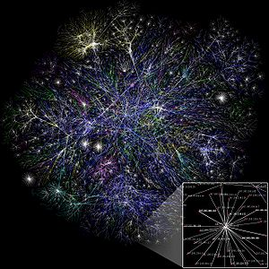





We Live in an Information Era
A visualization of the topology of
a portion of the Internet.
Web 2.0

Slide 3
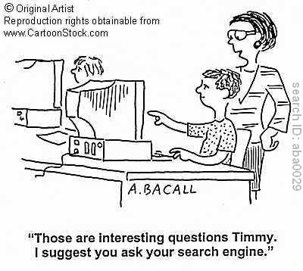
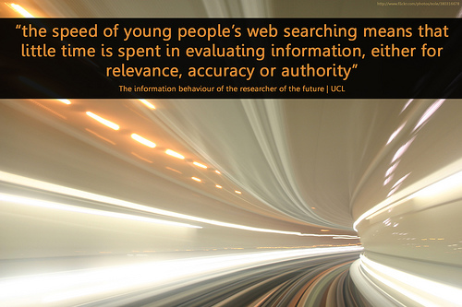
But the Freely Accessible Information Has Its Downside
Notes:
The British Library study revealed another concern: “The speed of young people’s internet searching indicates that little time is spent in evaluating information, either for relevance, accuracy or authority. Researchers have similarly found young people give a consistent lack of attention to the issue of authority. In one study, many teenagers thought if a site was indexed by Yahoo it had to be authoritative.”

Slide 4
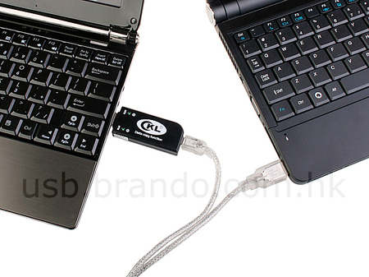
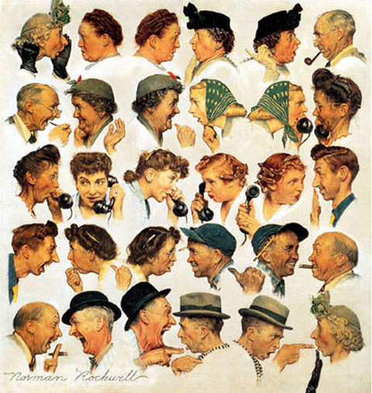

Information Propagation Becomes Much Easier with the Web Technologies

Slide 5
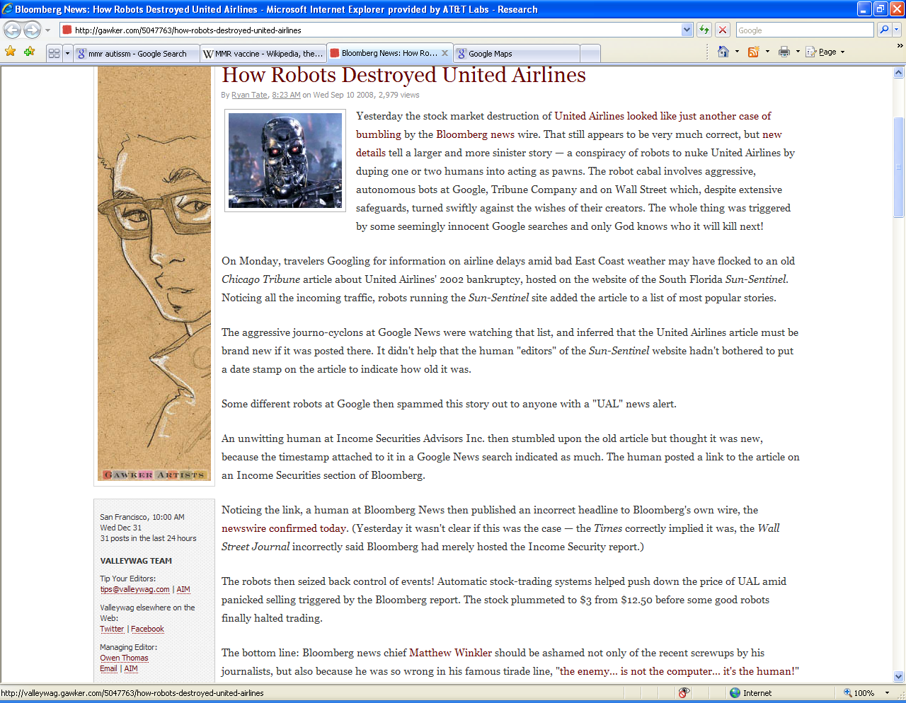
False Information Can Be Propagated (I)
UA’s bankruptcy
Chicago Tribune, 2002
Sun-Sentinel.com
Google News
Bloomberg.com
The UAL stock plummeted to $3 from $12.5

Slide 6


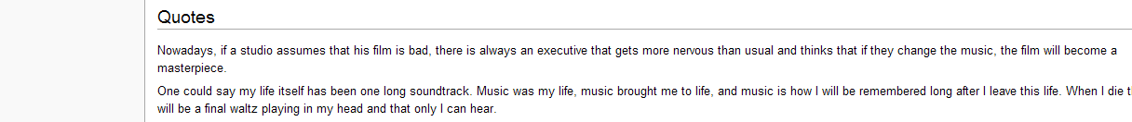
False Information Can Be Propagated (II)
Maurice Jarre (1924-2009) French Conductor and Composer
“One could say my life itself has been one long soundtrack. Music was my life, music brought me to life, and music is how I will be remembered long after I leave this life. When I die there will be a final waltz playing in my head and that only I can hear.”
2:29, 30 March 2009
Notes:
While I expected online blogs and maybe some smaller papers to use the quote, I did not think it would have a major impact. I was wrong. Quality newspapers in England, India, America and as far away as Australia had my words in their reports of Jarre’s death. I was shocked that highly respected newspapers would use material from Wikipedia without first sourcing and referencing it properly.

Slide 7
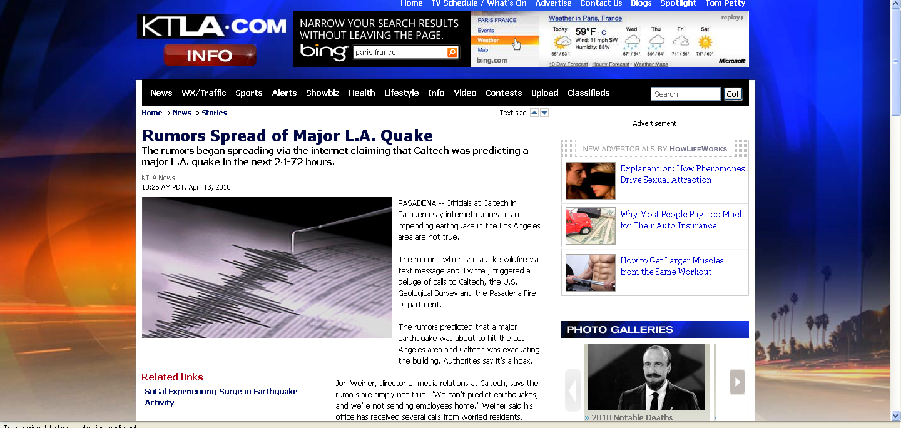
False Information Can Be Propagated (III)
Pasadena Fire Department …received several calls Monday from people saying they heard a quake was imminent
Notes:
While I expected online blogs and maybe some smaller papers to use the quote, I did not think it would have a major impact. I was wrong. Quality newspapers in England, India, America and as far away as Australia had my words in their reports of Jarre’s death. I was shocked that highly respected newspapers would use material from Wikipedia without first sourcing and referencing it properly.

Slide 8





False Information Can Be Propagated (IV)
Posted by Andrew Breitbart
In his blog
…
Notes:
On July 19, 2010, Shirley Sherrod was forced to resign from her position as Georgia State Director of Rural Development for the United States Department of Agriculture^{[1]} after conservative blogger Andrew Breitbart posted video excerpts of Sherrod's address at a March 2010 NAACP event to his website.^{[2]} The NAACP condemned her remarks, and U.S. government officials called on her to resign. However, upon review of the unedited video in context, the NAACP, White House officials, and Tom Vilsack, the Secretary of Agriculture, apologized and Sherrod was offered a new position.
The first news outlet to report on the Breitbart video was FoxNews.com, which posted an article about the story on its website.^{[16][14]} The New York City affiliate for CBS also posted a report on its website later that afternoon.^{[14]} The Atlanta Journal Constitution newspaper's related website also soon picked up the story.^{[17]} In addition, the story was picked up and reported widely in the blogosph
According to Sherrod, that afternoon she received numerous demands from government officials to submit her resignation, demands that she characterized as harrassment.^{[18]} In response to a call from USDA deputy undersecretary Cheryl Cook, Sherrod submitted her resignation via email. Sherrod claims that Cook told her White House officials wanted her to quit immediately because the controversy was "going to be on Glenn Beck tonight^{[18]} ", a claim disputed by White House Press Secretary Robert Gibbs.^{[6]}ere.^{[14]}

Slide 9
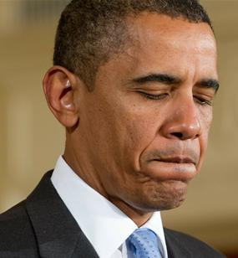
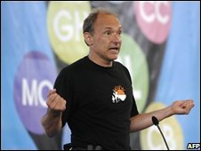
We now live in this media culture where something goes up on YouTube or a blog and everybody scrambles. - Barack Obama
The Internet needs a way to help people separate rumor from real science.
– Tim Berners-Lee

Slide 10



















Copying Can Happen on Structured Data
(Copying of Weather Data)

Slide 11
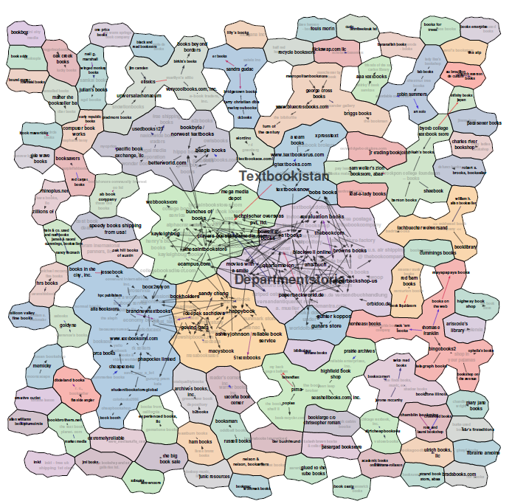
Copying Can Be Large Scaled
(Copying of AbeBooks Data)
Data collected from AbeBooks
[Yin et al., 2007]

Slide 12
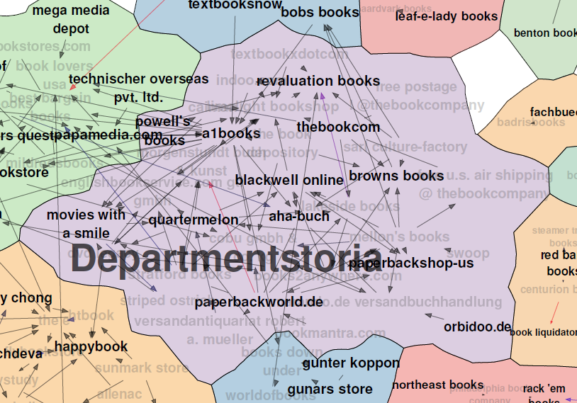
Intuitively Meaningful Clusters According to the Copying Relationships

Slide 13
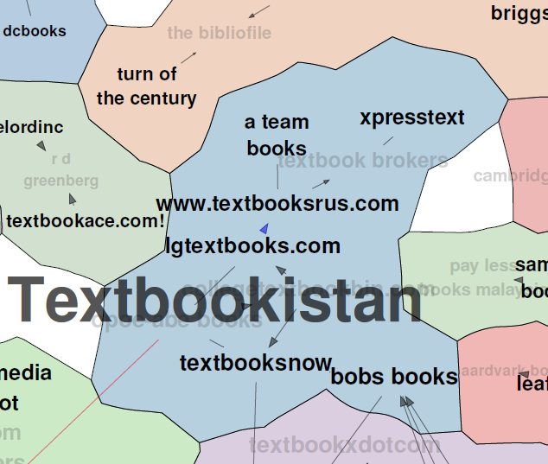
Intuitively Meaningful Clusters According to the Copying Relationships

Slide 14
Copying Can Be Large Scaled
(Copying of AbeBooks Data)

Slide 15
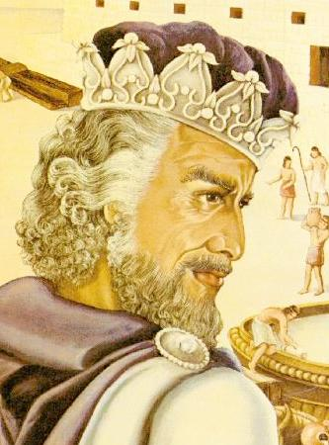
Solomon
Goal
  Discover copying relationships between structured data sources
  Leverage the copying relationships to improve various components of data integration
Other applications
  Business purpose: data are valuable
  In-depth data analysis: information dissemination

Slide 16
Outline
Copying discovery
Applications in
data integration
Local detection
[VLDB’09a]
Global detection
[VLDB’10a]
Detection w. dynamic data [VLDB’09b]
Visualization
Decision explanation
[VLDB’10 demo]
Truth discovery
[VLDB’09a][VLDB’09b]
Query answering
[Submitted]
Record linkage
[VLDB’10b]
Visualization and decision explanation
Solomon

Slide 17
Problem Definition—Input
Objects: a real-world entity, described by a set of attributes
  Each associated w. a true value
Sources: each providing data for a subset of objects
Input
Src | ISBN | Name | Author
S1 | 1 | IPV6: Theory, Protocol, and Practice | Loshin, Peter
 | 2 | Web Usability: A User-Centered Design Approach | Lazar, Jonathan
S2 | 1 | IPV4: Theory, Protocol, and Practice | -
 | 2 | Web Usability: A User | Jonathan Lazar
S3 | 1 | IPV6: Theory, Protocol, and Practice | Loshin, Peter
 | 2 | Web Usability: A User | Jonathan Lazar
S4 | 1 | IPV6: Theory, Protocol, and Practice | Loshin
 | 2 | Web Usability: A User | Lazar
Missing values
Incorrect
values
Different formats

Slide 18
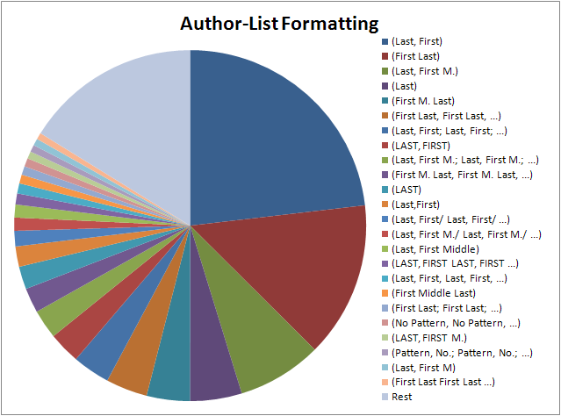
Formatting Patterns for Author List
Notes:
Emphasize diversity

Slide 19
Problem Definition—Output
For each S1, S2, decide pr of S1 copying directly from S2
  A copier copies all or a subset of data
  A copier can add values and verify/modify copied values—independent contribution
  A copier can re-format copied values—still considered as copied
Src | ISBN | Name | Author
S1 | 1 | IPV6: Theory, Protocol, and Practice | Loshin, Peter
 | 2 | Web Usability: A User-Centered Design Approach | Lazar, Jonathan
S2 | 1 | IPV4: Theory, Protocol, and Practice | -
 | 2 | Web Usability: A User | Jonathan Lazar
S3 | 1 | IPV6: Theory, Protocol, and Practice | Loshin, Peter
 | 2 | Web Usability: A User | Jonathan Lazar
S4 | 1 | IPV6: Theory, Protocol, and Practice | Loshin
 | 2 | Web Usability: A User | Lazar
S1
S2
S3
S4

Slide 20
Challenges in Copying Detection
Sharing data may be due to both sources providing accurate data
A copier can copy only a small fraction of data
With only a snapshot it is hard to decide which source is a copier
Copying relationship can be complex: co-copying, transitive copying
Src | ISBN | Name | Author
S1 | 1 | IPV6: Theory, Protocol, and Practice | Loshin, Peter
 | 2 | Web Usability: A User-Centered Design Approach | Lazar, Jonathan
S2 | 1 | IPV4: Theory, Protocol, and Practice | -
 | 2 | Web Usability: A User | Jonathan Lazar
S3 | 1 | IPV6: Theory, Protocol, and Practice | Loshin, Peter
 | 2 | Web Usability: A User | Jonathan Lazar
S4 | 1 | IPV6: Theory, Protocol, and Practice | Loshin
 | 2 | Web Usability: A User | Lazar
S1
S2
S3
S4

Slide 21
High-Level Intuitions for Copying Detection
Pr(Ф(S1)|S1→S2) >> Pr(Ф(S1)|S1⊥S2) S1→S2
Intuition I: decide dependence (w/o direction)
  For shared data, Pr(Ф(S1)|S1⊥S2) is low
  e.g., incorrect value

Slide 22


Copying?
Not necessarily
Name: Alice Score: 5
A
C
D
C
B
D
B
A
B
C
Name: Bob Score: 5
A
C
D
C
B
D
B
A
B
C
✓
✓
✓
✓
✓
✓
✓
✓
✓
✓
✓
✓
✓
✓
✓
✓
✓
✓
✓
✓

Slide 23


Copying?—Common Errors
Very likely
Name: Mary Score: 1
A
B
B
D
A
C
C
D
E
C
Name: John Score: 1
A
B
B
D
A
C
C
D
E
B
✓
✓
✗
✗
✗
✗
✗
✗
✗
✗
✗
✗
✗
✗
✗
✗
✗
✗
✓
✗

Slide 24
High-Level Intuitions for Copying Detection
Pr(Ф(S1)|S1→S2) >> Pr(Ф(S1)|S1⊥S2) S1→S2
Intuition I: decide dependence (w/o direction)
  For shared data, Pr(Ф(S1)|S1⊥S2) is low
  e.g., incorrect data
Intuition II: decide copying direction
  Let F be a property function of the data
  (e.g., accuracy of data)
  |F(Ф(S1) ∩ Ф(S2))-F(Ф(S1)-Ф(S2))|
  > |F(Ф(S1) ∩ Ф(S2))-F(Ф(S2)-Ф(S1))| .

Slide 25
Copying?—Different Accuracy
John copies from Alice
Name: Alice Score: 3
B
B
D
D
B
D
D
A
B
C
Name: John Score:1
B
B
D
D
B
C
C
D
E
B
✗
✗
✗
✗
✓
✓
✗
✗
✓
✓
✓
✗
✗
✗
✓
✗
✗
✗
✓
✗

Slide 26
Copying?—Different Accuracy
Alice copies from John
Name: Alice Score: 3
A
B
B
D
A
D
B
A
B
C
Name: John Score: 1
A
B
B
D
A
C
C
D
E
B
✓
✓
✗
✗
✗
✗
✗
✗
✗
✗
✓
✗
✓
✗
✓
✗
✓
✗
✓
✗

Slide 27
Bayesian Analysis – Basic
S1 ∩ S2
Different Values O.A_{d}
Same Values
TRUE O.A_{t}
FALSE O.A_{f}
Observation: Ф
Goal: Pr(S1⊥S2| Ф), Pr(S1∼S2| Ф) (sum up to 1)
According to the Bayes Rule, we need to know
Pr(Ф|S1⊥S2), Pr(Ф|S1∼S2)
Key: computing Pr(Ф_{O.A}|S1⊥S2), Pr(Ф_{O.A}|S1∼S2)
for each O.A∈S1 ∩ S2

Slide 28
Bayesian Analysis – Probability Computation
S1 ∩ S2
Different Values O.A_{d}
Same Values
TRUE O.A_{t}
FALSE O.A_{f}
Pr | Independence | Copying
O.A_{t}
O.A_{f}
O.A_{d}
<
<
>
ε-error rate; n-#wrong-values; c-copy rate

Slide 29
Considering Source Accuracy
S1 ∩ S2
Different Values O.A_{d}
Same Values
TRUE O.A_{t}
FALSE O.A_{f}
Pr | Independence | S1 Copies S2 | S2 Copies S1
O.A_{t}
O.A_{f}
O.A_{d}
≠
≠

Slide 30
Correctness of Data as Evidence for Copying
Src | ISBN | Name | Author
S1 | 1 | IPV6: Theory, Protocol, and Practice | Loshin, Peter
 | 2 | Web Usability: A User-Centered Design Approach | Lazar, Jonathan
S2 | 1 | IPV4: Theory, Protocol, and Practice | -
 | 2 | Web Usability: A User | Jonathan Lazar
S3 | 1 | IPV6: Theory, Protocol, and Practice | Loshin, Peter
 | 2 | Web Usability: A User | Jonathan Lazar
S4 | 1 | IPV6: Theory, Protocol, and Practice | Loshin
 | 2 | Web Usability: A User | Lazar
S1
S2
S3
S4

Slide 31
Extending the Basic Technique
Consider correctness
of data [VLDB’09a]
Consider additional evidence [VLDB’10a]

Slide 32
Formatting as Evidence for Copying
Src | ISBN | Name | Author
S1 | 1 | IPV6: Theory, Protocol, and Practice | Loshin, Peter
 | 2 | Web Usability: A User-Centered Design Approach | Lazar, Jonathan
S2 | 1 | IPV4: Theory, Protocol, and Practice | -
 | 2 | Web Usability: A User | Jonathan Lazar
S3 | 1 | IPV6: Theory, Protocol, and Practice | Loshin, Peter
 | 2 | Web Usability: A User | Jonathan Lazar
S4 | 1 | IPV6: Theory, Protocol, and Practice | Loshin
 | 2 | Web Usability: A User | Lazar
S1
S2
S3
S4
SubValues
Different formats

Slide 33
Extending the Basic Technique
Consider correctness
of data [VLDB’09a]
Consider additional evidence [VLDB’10a]
Consider correlated copying [VLDB’10a]

Slide 34
Correlated Copying
 | K | A1 | A2 | A3 | A4
O1 | S | S | S | D | D
O2 | S | D | S | S | D
O3 | S | S | D | S | D
O4 | S | S | S | D | S
O5 | S | D | S | S | S
 | K | A1 | A2 | A3 | A4
O1 | S | S | S | S | S
O2 | S | S | S | S | S
O3 | S | S | S | S | S
O4 | S | D | D | D | D
O5 | S | D | D | D | D
17 same values, and 8 different values
17 same values, and 8 different values
Copying
S: Two sources providing the same value
D: Two sources providing different values

Slide 35
Extending the Basic Technique
Local Detection
Global Detection [VLDB’10a]
Consider correctness
of data [VLDB’09a]
Consider additional evidence [VLDB’10a]
Consider correlated copying [VLDB’10a]
Consider updates [VLDB’09b]

Slide 36
Multi-Source Copying? Co-copying? Transitive Copying?
S1{V1-V100}
(V81-V100 are popular values)
{V1-V50,
V101-V130}
S2
S3
{V51-V130}
Multi-source copying
S1{V1-V100}
S1{V1-V100}
S2
S3
S2
S3
{V21-V50,
V81-V100}
{V1-V50}
{V21-V70}
{V1-V50}
Co-copying
Transitive copying

Slide 37
Multi-Source Copying? Co-copying? Transitive Copying?
S1{V1-V100}
(V81-V100 are popular values)
{V1-V50,
V101-V130}
S2
S3
{V51-V130}
Multi-source copying
S1{V1-V100}
S1{V1-V100}
S2
S3
S2
S3
{V21-V50,
V81-V100}
{V1-V50}
{V21-V70}
{V1-V50}
Co-copying
Transitive copying
Local copying detection results

Slide 38
Multi-Source Copying? Co-copying? Transitive Copying?
S1{V1-V100}
(V81-V100 are popular values)
{V1-V50,
V101-V130}
S2
S3
{V51-V130}
Multi-source copying
S1{V1-V100}
S1{V1-V100}
S2
S3
S2
S3
{V21-V50,
V81-V100}
{V1-V50}
{V21-V70}
{V1-V50}
Co-copying
Transitive copying
- Looking at the copying probabilities?

Slide 39
Multi-Source Copying? Co-copying? Transitive Copying?
S1{V1-V100}
(V81-V100 are popular values)
1
1
{V1-V50,
V101-V130}
S2
S3
{V51-V130}
1
Multi-source copying
S1{V1-V100}
S1{V1-V100}
1
1
1
1
S2
S3
S2
S3
{V21-V50,
V81-V100}
{V1-V50}
{V21-V70}
{V1-V50}
1
1
Co-copying
Transitive copying
X Looking at the copying probabilities?
- Counting shared values?

Slide 40
Multi-Source Copying? Co-copying? Transitive Copying?
S1{V1-V100}
(V81-V100 are popular values)
50
50
{V1-V50,
V101-V130}
S2
S3
{V51-V130}
30
Multi-source copying
S1{V1-V100}
S1{V1-V100}
50
50
50
50
S2
S3
S2
S3
{V21-V50,
V81-V100}
{V1-V50}
{V21-V70}
{V1-V50}
30
30
Co-copying
Transitive copying
X Looking at the copying probabilities?
X Counting shared values?
- Comparing the set of shared values?

Slide 41
Multi-Source Copying? Co-copying? Transitive Copying?
S1{V1-V100}
(V81-V100 are popular values)
V1-V50
V51-V100
{V1-V50,
V101-V130}
S2
S3
{V51-V130}
V101-V130
Multi-source copying
S1{V1-V100}
S1{V1-V100}
V1-V50
V21-V70
V1-V50
V21-V50, V81-V100
S2
S3
S2
S3
{V21-V50,
V81-V100}
{V1-V50}
{V21-V70}
{V1-V50}
V21-V50
V21-V50
Co-copying
Transitive copying
X Looking at the copying probabilities?
X Counting shared values?
- Comparing the set of shared values?

Slide 42
Multi-Source Copying? Co-copying? Transitive Copying?
S1{V1-V100}
(V81-V100 are popular values)
V1-V50
V51-V100
{V1-V50,
V101-V130}
S2
S3
{V51-V130}
V101-V130
Multi-source copying
S1{V1-V100}
S1{V1-V100}
V1-V50
V21-V70
V1-V50
V21-V50, V80-V100
S2
S3
S2
S3
{V21-V50,
V81-V100}
{V1-V50}
{V21-V70}
{V1-V50}
V21-V50
V21-V50
Co-copying
V21-V50 shared by 3 sources
Transitive copying
X Looking at the copying probabilities?
X Counting shared values?
X Comparing the set of shared values?
We need to reason for each data item in a principled way!
Notes:
Not enough to look at only agg info

Slide 43

Global Copying Detection
Find a set of copyings R that significantly influence the rest of the copyings
  Maximize
  Finding R is NP-complete
  We propose a fast greedy algorithm
Adjust copying probability for the rest of the copyings: P(S1→S2|R)
  Replace Pr(Ф_{O.A}(S1)|S1⊥S2) everywhere with
  Pr(Ф_{O.A} (S1)|S1⊥S2, R), which considers sources that S1 copies from according to R and provide the same value on O.A as S1
Pr(Ф(S1)|S1→S2) >> Pr(Ф(S1)|S1⊥S2) S1→S2

Slide 44
Multi-Source Copying? Co-copying? Transitive Copying?
S1{V1-V100}
(V81-V100 are popular values)
V1-V50
V51-V100
?
{V1-V50,
V101-V130}
S2
S3
{V51-V130}
V101-V130
Multi-source copying
R={S3→S1}, Pr(Ф(S3))= Pr(Ф(S3)|R) for V101-V130
S1{V1-V100}
S1{V1-V100}
?
X
V1-V50
V21-V70
V1-V50
V21-V50, V81-V100
X
?
S2
S3
S2
S3
{V21-V50,
V81-V100}
{V1-V50}
{V21-V70}
{V1-V50}
V21-V50
V21-V50
Co-copying
Transitive copying
R={S3→S1},
Pr(Ф(S3))<<Pr(Ф(S3)|R)
for V21-V50
R={S3→S2},
Pr(Ф(S3))<<Pr(Ф(S3)|R) for V21-V50
Pr(Ф(S3)) is high for V81-V100

Slide 45
Experiment Setup
18 weather websites
for 30 major USA cities
collected every 45 minutes for a day
33 collections, so 990 objects
28 distinct attributes in total

Slide 46
Silver Standard
18 weather websites
for 30 major USA cities
collected every 45 minutes for a day
33 collections, so 990 objects
28 distinct attributes in total

Slide 47
Experiment Results
Measure: Precision, Recall, F-measure
  C: real copying; D: detected copying
Enriched improves over Corr when true/false notion does apply
Methods | Precision | Recall | F-measure
Corr (Only correctness) | .5 | .43 | .46
Enriched (More evidence) | 1 | .14 | .25
Local (correlated copying) | .33 | .86 | .48
Global (global detection) | .79 | .79 | .79
Transitive/co-copying
not removed
Ignoring evidence from
correlated copying

Slide 48
What Is Missing? (a.k.a. Future Work)
Local Detection
Global Detection
Consider correctness
of data [VLDB’09a]
Consider additional evidence [VLDB’10a]
Consider correlated copying [VLDB’10a]
Consider updates [VLDB’09b]

Slide 49
What Is Missing? (a.k.a. Future Work)
Local Detection
Global Detection
Loop copying
Copying by category
Summarizing copying patterns
Exploring evidence from schemas, tuple ordering, etc.
Scalability
Detecting opinion influence
Hidden Sources
Global detection for dynamic data

Slide 50
Outline
Copying discovery
Applications in
data integration
Local detection
[VLDB’09a]
Global detection
[VLDB’10a]
Detection w. dynamic data [VLDB’09b]
Visualization
Decision explanation
[VLDB’10 demo]
Truth discovery
[VLDB’09a][VLDB’09b]
Query answering
[Submitted]
Record linkage
[VLDB’10b]
Visualization and decision explanation
Solomon

Slide 51
Data Integration Faces 3 Challenges
Data Conflicts
Instance Heterogeneity
Structure Heterogeneity

Slide 52
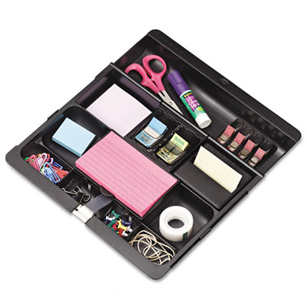
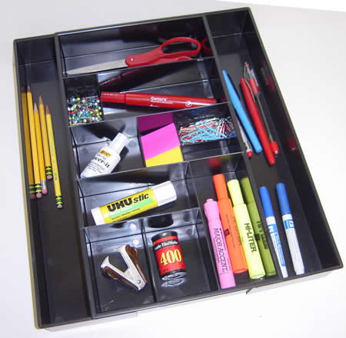
Data Integration Faces 3 Challenges
Data Conflicts
Instance Heterogeneity
Structure Heterogeneity

Slide 53
Data Integration Faces 3 Challenges
Scissors
Data Conflicts
Instance Heterogeneity
Structure Heterogeneity
Paper Scissors

Slide 54
Data Integration Faces 3 Challenges
Scissors
Data Conflicts
Instance Heterogeneity
Structure Heterogeneity
Glue

Slide 55
Existing Solutions Assume Independence of Data Sources
Data Conflicts
Instance Heterogeneity
Structure Heterogeneity
Assume INDEPENDENCE
of data sources
Data fusion
Truth discovery
String matching (edit distance, token-based, etc.)
Object matching (aka. record linkage, reference reconciliation, …)
Schema matching
Model management
Query answering using views
Information extraction

Slide 56
Source Copying Adds A New Dimension to Data Integration
Data Conflicts
Instance Heterogeneity
Structure Heterogeneity
Query
Answering
Data
Fusion
Record
Linkage
Truth discovery
[VLDB’09a, VLDB’09b]
Integrating probabilistic data
Improve record linkage
Distinguish bet wrong values and alter representations [VLDB’10b]
Query optimization [Submitted]
Improve schema matching
Source Recom-mendation
Recommend trustworthy, up-to-date, and independent sources

Slide 57
Application I. Truth Discovery—Naïve Voting
 | S1 | S2 | S3
Stonebraker | MIT | Berkeley | MIT
Dewitt | MSR | MSR | UWisc
Bernstein | MSR | MSR | MSR
Carey | UCI | AT&T | BEA
Halevy | Google | Google | UW
Notes:
(American short-story Writer and Novelist, Nobel Prize for Literature in 1949, 1897-1962)

Slide 58
Application I. Truth Discovery—Naïve Voting
 | S1 | S2 | S3 | S4 | S5
Stonebraker | MIT | Berkeley | MIT | MIT | MS
Dewitt | MSR | MSR | UWisc | UWisc | UWisc
Bernstein | MSR | MSR | MSR | MSR | MSR
Carey | UCI | AT&T | BEA | BEA | BEA
Halevy | Google | Google | UW | UW | UW
Notes:
(American short-story Writer and Novelist, Nobel Prize for Literature in 1949, 1897-1962)

Slide 59
Application I. Truth Discovery—Our Solution
 | S1 | S2 | S3 | S4 | S5
Stonebraker | MIT | Berkeley | MIT | MIT | MS
Dewitt | MSR | MSR | UWisc | UWisc | UWisc
Bernstein | MSR | MSR | MSR | MSR | MSR
Carey | UCI | AT&T | BEA | BEA | BEA
Halevy | Google | Google | UW | UW | UW
S₁
UCI
AT&T
.87
.2
S1
S2
S₂
.2
.99
S₃
BEA
.99
S3
S₄
.99
S₅
Copying Relationship
S4
S5
(1-.99*.8=.2)
(.2²)
Round 1
Truth Discovery
Notes:
(American short-story Writer and Novelist, Nobel Prize for Literature in 1949, 1897-1962)

Slide 60
Application I. Truth Discovery—Our Solution
 | S1 | S2 | S3 | S4 | S5
Stonebraker | MIT | Berkeley | MIT | MIT | MS
Dewitt | MSR | MSR | UWisc | UWisc | UWisc
Bernstein | MSR | MSR | MSR | MSR | MSR
Carey | UCI | AT&T | BEA | BEA | BEA
Halevy | Google | Google | UW | UW | UW
S₁
UCI
AT&T
.14
S1
S2
S₂
.08
S₃
.49
BEA
.49
.49
.49
S3
.49
S₄
.49
S₅
Copying Relationship
S4
S5
Round 2
Truth Discovery
Notes:
(American short-story Writer and Novelist, Nobel Prize for Literature in 1949, 1897-1962)

Slide 61
Application I. Truth Discovery—Our Solution
 | S1 | S2 | S3 | S4 | S5
Stonebraker | MIT | Berkeley | MIT | MIT | MS
Dewitt | MSR | MSR | UWisc | UWisc | UWisc
Bernstein | MSR | MSR | MSR | MSR | MSR
Carey | UCI | AT&T | BEA | BEA | BEA
Halevy | Google | Google | UW | UW | UW
UCI
S₁
AT&T
.12
S1
S2
S₂
.06
S₃
.49
BEA
.49
.49
.49
S3
.49
S₄
.49
S₅
Copying Relationship
S4
S5
Round 3
Truth Discovery
Notes:
(American short-story Writer and Novelist, Nobel Prize for Literature in 1949, 1897-1962)

Slide 62
Application I. Truth Discovery—Our Solution
 | S1 | S2 | S3 | S4 | S5
Stonebraker | MIT | Berkeley | MIT | MIT | MS
Dewitt | MSR | MSR | UWisc | UWisc | UWisc
Bernstein | MSR | MSR | MSR | MSR | MSR
Carey | UCI | AT&T | BEA | BEA | BEA
Halevy | Google | Google | UW | UW | UW
UCI
AT&T
S₁
.10
S1
S2
S₂
.05
S₃
.49
BEA
.49
.48
.50
S3
.48
S₄
.50
S₅
Copying Relationship
S4
S5
Round 4
Truth Discovery
Notes:
(American short-story Writer and Novelist, Nobel Prize for Literature in 1949, 1897-1962)

Slide 63
Application I. Truth Discovery—Our Solution
 | S1 | S2 | S3 | S4 | S5
Stonebraker | MIT | Berkeley | MIT | MIT | MS
Dewitt | MSR | MSR | UWisc | UWisc | UWisc
Bernstein | MSR | MSR | MSR | MSR | MSR
Carey | UCI | AT&T | BEA | BEA | BEA
Halevy | Google | Google | UW | UW | UW
UCI
AT&T
S₁
.09
S1
S2
S₂
.04
S₃
.49
BEA
.49
.47
.51
S3
.47
S₄
.51
S₅
Copying Relationship
S4
S5
Round 5
Truth Discovery
Notes:
(American short-story Writer and Novelist, Nobel Prize for Literature in 1949, 1897-1962)

Slide 64
Application I. Truth Discovery—Our Solution
 | S1 | S2 | S3 | S4 | S5
Stonebraker | MIT | Berkeley | MIT | MIT | MS
Dewitt | MSR | MSR | UWisc | UWisc | UWisc
Bernstein | MSR | MSR | MSR | MSR | MSR
Carey | UCI | AT&T | BEA | BEA | BEA
Halevy | Google | Google | UW | UW | UW
UCI
AT&T
S₁
S1
S2
S₂
.49
S₃
.49
.44
.55
BEA
.55
S3
S₄
.44
S₅
S4
S5
Copying Relationship
Round 13
Truth Discovery
Notes:
(American short-story Writer and Novelist, Nobel Prize for Literature in 1949, 1897-1962)

Slide 65
Application I. Truth Discovery (Con’t)
Step 2
Truth
Discovery
Source-accuracy
Computation
Copying
Detection
Step 3
Step 1
Theorem: w/o accuracy, converges
Observation: w. accuracy, converges when #objs >> #srcs

Slide 66
Experiment on Static Data [VLDB’09a]
Dataset: AbeBooks
  877 bookstores
  1265 CS books
  24364 listings, w. ISBN, name, author-list
  After pre-cleaning, each book on avg has 19 listings and 4 author lists (ranges from 1-23)
Golden standard: 100 random books
  Manually check author list from book cover
Measure: Precision=#(Corr author lists)/#(All lists)

Slide 67
Naïve Voting and Types of Errors
Naïve voting has precision .71
Error type | Num
Missing authors | 23
Additional authors | 4
Mis-ordering | 3
Mis-spelling | 2
Incomplete names | 2

Slide 68
Contributions of Various Components
Considering copying improves the results most
Methods | Prec | #Rnds | Time(s)
Naïve | .71 | 1 | .2
Only value similarity | .74 | 1 | .2
Only source accuracy | .79 | 23 | 1.1
Only source copying | .83 | 3 | 28.3
Copy+accu | .87 | 22 | 185.8
Copy+accu+sim | .89 | 18 | 197.5
Precision improves by 25.4% over Naïve
Reasonably fast

Slide 69
Experiment on Dynamic Data [VLDB’09b]
Dataset: Manhattan restaurants
  Data crawled from 12 restaurant websites
  8 versions: weekly from 1/22/2009 to 3/12/2009
  5269 restaurants, 5231 appearing in the first crawling and 5251 in the last crawling
  467 restaurants deleted from some websites, 280 closed before 3/15/2009 (Golden standard)
Measure: Precision, Recall, F-measure
  G: really closed restaurants; D: detected closed restaurants

Slide 70











Discovered Copying
Between 12 out of 66 pairs copying is likely

Slide 71
Contributions of Various Components
Naïve missed a lot of restaurants
Applying rules is inadequate
Method | Ever-existing | Closed |  |  | #Rnds | Time(s)
 | #Rest | Prec | Rec | F-msr
ALL | - | .60 | 1.0 | .75 | - | -
ALL2 | - | .94 | .34 | .50 | - | -
Naïve | 1192 | .70 | .93 | .80 | 1 | 158
Quality | 5068 | .83 | .88 | .85 | 7 | 637
CopyQua | 5186 | .86 | .87 | .86 | 6 | 1408
Google | - | .84 | .19 | .30 | - | -
Quality and CopyQua obtain high precision and recall
Google Map listed a lot of out-of-business restaurants

Slide 72
Application II. Query Optimization in DI
S1{V1-V100}
S2{V101-V200}
50%
100%
100%
50%
{V201-V250}
S3
S4
{V251-V300}
S5
100%
100%
80%
S6
Minimize #sources: {S5, S6}
Minimize #tuples: {S3, S4, S5}

Slide 73
Key Problems in IDS
Goal: return only independently provided data
Key problems
  Coverage: fraction of answers returned by a subset of sources
  Cost minimization: minimal set of sources to retrieve all answers
  Maximum coverage: set of sources to retrieve the maximum set of answers under a resource bound
  Source ordering: best ordering of data sources to provide more answers quickly

Slide 74
Complexity of Computing Coverage
 | Exact Solution | (ε, δ)-Approximation
Copy a fraction of data | #P-complete | O(LNE)
Copy all data | O(N + E) | N/A
Copy w. select predicate | Attr. Dep: O((2bE)^{k}(N + E)) Attr. Indep: O(bkE(N + E)) | N/A
N- #sources; E-#copyings; L =
k - #attributes w. selection predicates
b - maximum number of constants in predicates for each attribute for each copying

Slide 75
Complexity of Source Selection/Ordering Problems
 | Exact Solution | Approximation
Cost Minimization | NP-complete, MaxSNP-hard | log α-approx (w. PTIME coverage solution)
Maximum Coverage | PP-hard | (1 − 1/e )-approx (w. PTIME coverage solution)
Source Ordering | PP-hard | 2-approx (w. PTIME coverage solution)

Slide 76
What is Missing (a.k.a. Future Work)
Data Conflicts
Instance Heterogeneity
Structure Heterogeneity
Query
Answering
Data
Fusion
Record
Linkage
Truth discovery
[VLDB’09a, VLDB’09b]
Integrating probabilistic data
Improve record linkage
Distinguish bet wrong values and alter representations [VLDB’10b]
Query optimization [Submitted]
Improve schema matching
Source Recom-mendation
Recommend trustworthy, up-to-date, and independent sources

Slide 77
Outline
Copying discovery
Applications in
data integration
Local detection
[VLDB’09a]
Global detection
[VLDB’10a]
Detection w. dynamic data [VLDB’09b]
Visualization
Decision explanation
[VLDB’10 demo]
Truth discovery
[VLDB’09a][VLDB’09b]
Query answering
[Submitted]
Record linkage
[VLDB’10b]
Visualization and decision explanation
Solomon

Slide 78
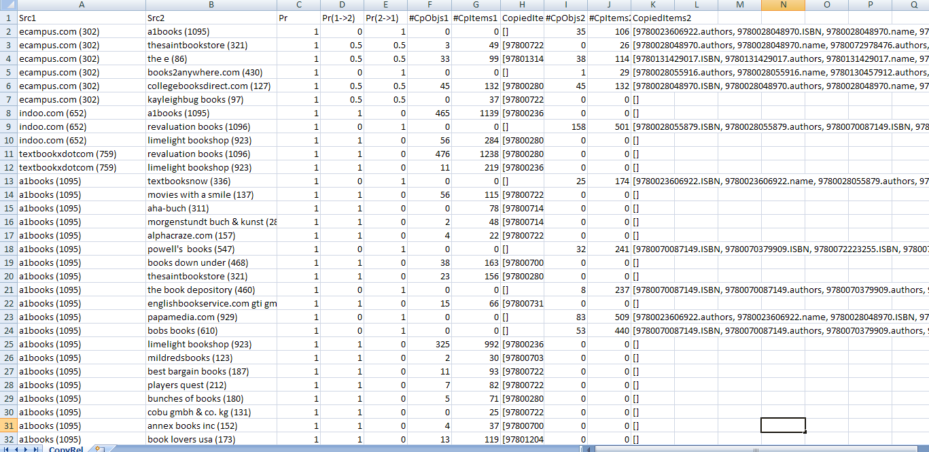
Copying of AbeBooks Data
AbeBooks data set:
  877 bookstores, 1265 CS books, 24364 listings
  Copying between 465 pairs of sources

Slide 79
A Picture Is Worth a Thousand Words [VLDB’10 Demo]

Slide 80
Demo Here

Slide 81
Future Work: Explaining Copying-Detection Decisions
  Provide the simplest, understandable explanation for Bayesian analysis
  A copying detection decision is complex
    Why copying?
    Why a particular copying pattern (per-object copying vs. per-attribute copying)?
    Why a particular copying direction?
    Why the local decision is different from the global decision?
Answer “what-if” questions
  What if the two sources actually use the same format for those common values?
  What if there is a hidden source that S1 and S2 both copy from?
Answer “comparison” questions
  Why S1 is a copier of S2 but not a copier of S3?
  Why S1 has copied attributes “title” but not “authors”?

Slide 82
Related Work
Copying detection
  Texts/Programs [Schleimer et al., 03][Buneman, 71]
  Videos [Law-To et al., 07]
  Structured sources
    [Dong et al., 09a] [Dong et al., 09b]: Local decision
    [Blanco et al., 10]: Assume a copier must copy all attribute values of an object
Data provenance [Buneman et al., PODS’08]
  Focus on effective presentation and retrieval
  Assume knowledge of provenance/lineage

Slide 83
Take-Aways
Copying is common on the Web
Detecting copying for structured data is possible and beneficial
Next step: reduce redundancy for quality
  How many sources are sufficient?
  How to help a user effectively explore the sources?

Slide 84

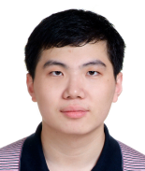
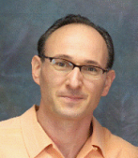
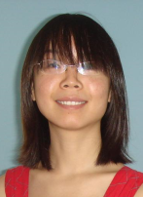






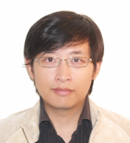
Acknowledgements
Divesh Srivastava
(AT&T Research)
Alon Halevy
(Google)
Yifan Hu
(AT&T Research)
Laure Berti-Equille
(Univ de Rennes 1)
Remi Zajac
(AT&T Interactive)
Songtao Guo
(AT&T Interactive)
Xuan Liu
(Singapore National Univ.)
Pei Li
(Univ di Milano-Bicocca)
Amelie Marian
(Rutgers Univ.)
Andrea Maurino
(Univ di Milano-Bicocca)
Anish Das Sarma
(Yahoo!)
Ordered by the amount of time spent at AT&T

Slide 85
Solomon: Seeking the Truth Via Copying Detection
http://www2.research.att.com/~yifanhu/SourceCopying/
Notes:
10+20+10+10+10
8+20+8+8+10

